Slide 1

Robot Obstacle avoidance with reinforcement learning
Group Members:
Alexandre Dietrich
Ankur Tyagi
Haitham Alamri
Rodolfo Vasconcelos
Intelligent Systems and Reinforcement Learning

Slide 2
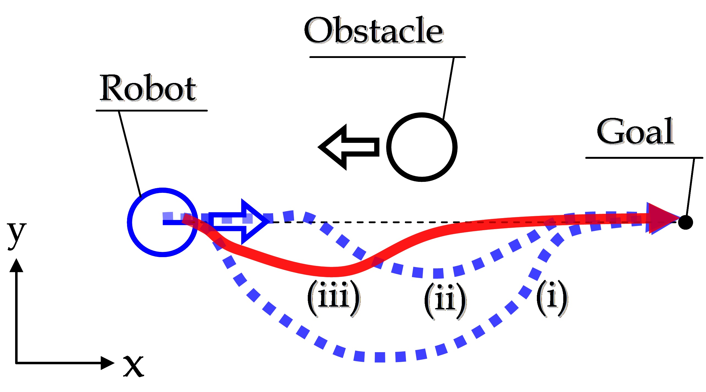
Problem Statement
Find the path for robot to reach an end point (goal state) while avoiding randomly generated obstacles in a 2D space

Slide 3
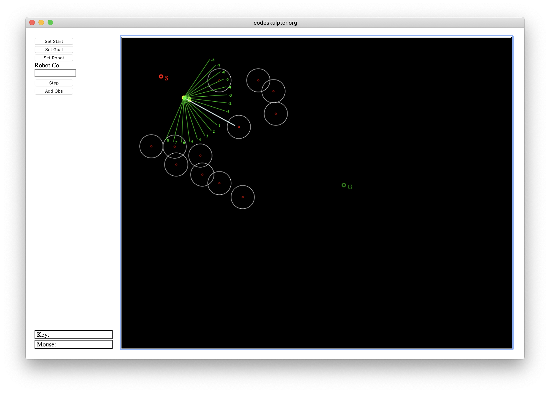
Environment
Environment simulation using python 3 for the project
Simulation Steps:
Choose the starting coordinates of the robot
Choose the target coordinates
Define static obstacles – generated randomly for each episode
Define number of sensors on the robot
Navigate the path using the step and avoid any incoming obstacles while navigating towards the target state.
Objectives:
Identify and optimize the algorithm to avoid the obstacle and reach the destination
Compare the efficiency of algorithms against each other.
*sample screen shot

Slide 4
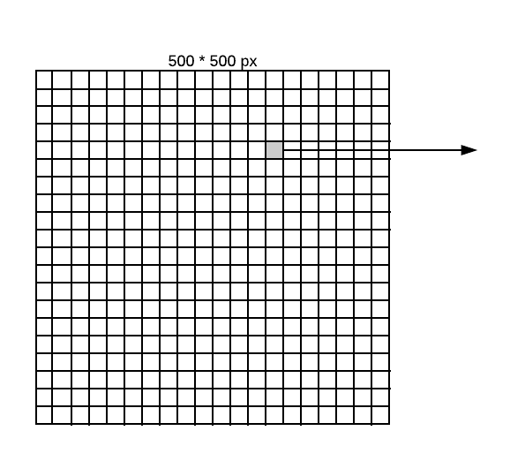
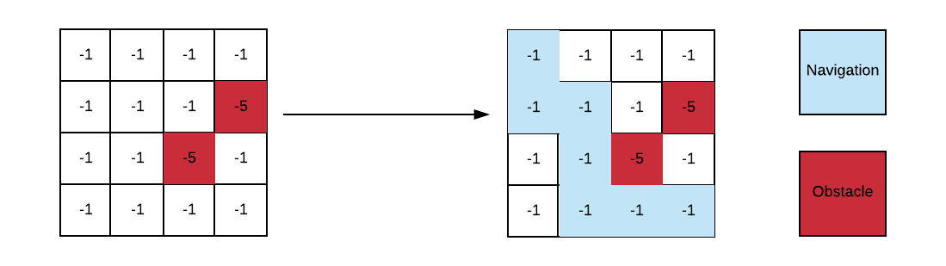
Solution Approach
Set the Canvas size to be 500*500 pixels Grid of 50*50px with each grid of 12.5 pixels Actions(s): Up, Down, Right and left Dynamically generated obstacles | States: all possible states within a 4 x 4 grid with 0 or more obstacles Reward function: -1 cost of step -5 cost of obstacle 0 goal end state
One grid - matrix with 2 possible obstacle

Slide 5
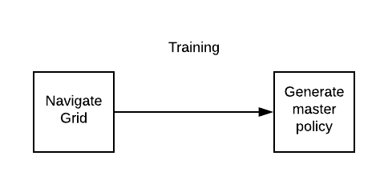
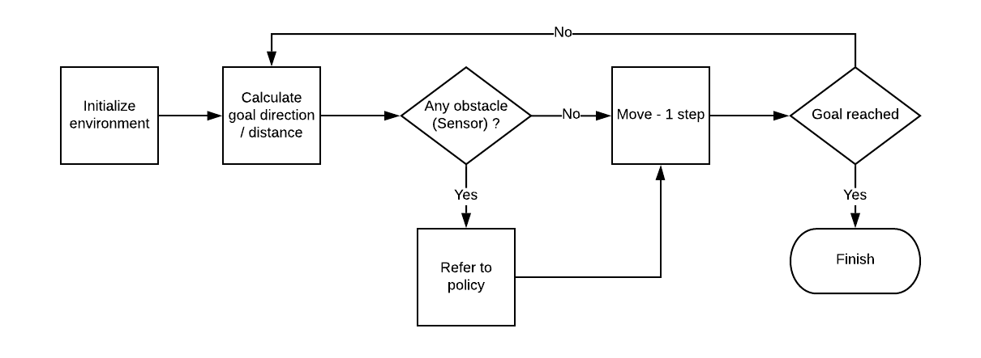
algorithm – 1 (Bayesian + static)
Execution Steps:
Environment: Starting point : top corner(0,0) End point - bottom right corner (500, 500) Monte-carlo method to simulate 1000’s of episodes and value iteration Find optimal q-value for every state in 4*4 grid and determine action based on epsilon soft policy algorithm The generated master policy is a dictionary of states and actions for all 50*50 grids Use the optimal policy to playing stage and then run through the agent from the starting point to the goal T(s'|s; a): probability of reaching s' if action a is taken in state s = 1 (No uncertainty)
Step - Run

Slide 6
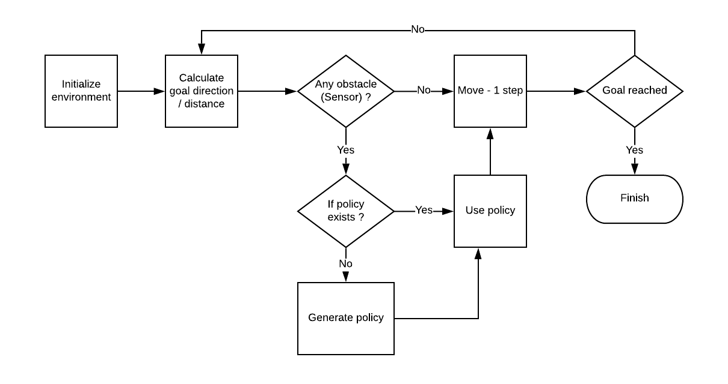
algorithm – 2 (Dynamic Bayesian policy)
Environment Dynamic start point for the robot Dynamic goal (end-point) for the robot In start of every episode robot begins without a policy | If a policy is not available for that state, a new policy is created using the same Monte Carlo method T(s'|s; a): probability of reaching s' if action a is taken in state s < 1 (some uncertainty)

Slide 7
algorithm – 3 (Extended Dynamic Policy)
Environment Dynamic start point for the robot Dynamic goal (end-point) for the robot Algorithm extension : In this algorithm, the policy matrix calculation is changed where the policy looks into nearby square matrix as well to define the path of the robot Grid calculation changed from 50*50 to 250 * 250px Instead of Monte-carlo in a grid of 4*4 , we are calculating a grid of 5*5.

Slide 8
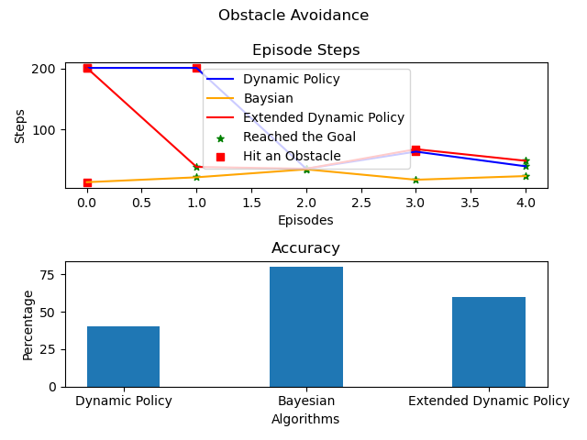
Algorithm Comparisons
Bayesian algorithm has the highest consistency among all the algorithm to navigate through obstacles

Slide 9
Conclusion – Lesson Learnt and future work
Lesson Learnt
1. How to assemble a 360
Possible extensions of the work include :
Use deep learning – q network to further increases the accuracy / calculation for the program.
Use deep deterministic policy gradient for solving the problem (from the Haitham video)

